Slide 1

OBJECT(VEHICLE)DETECTION AND COUNTING USING OPEN CV
INTERNAL GUIDE PRESENTED BY BATCH-A11
Mrs.Y.PADMA J.VENKATESWARARAO-20MG1A0431
Asst.PROFESSOR K.ANIL KUMAR -20MG1A0434
CH.SRIVIDYA -20MG1A0450
K.PUJITHA -20MG1A0416

Slide 2
CONTENTS
ABSTRACT
INTRODUCTION
EXISTING METHODS
PROPOSED METHODS
BLOCK DIAGRAM
ADVANTAGES
APPLICATIONS

Slide 3
ABSTRACT
The technology of detection within the captured video has implementation within the sort of fields. This emerging technology when implemented over the real-time video feeds could even be beneficial. The supreme good thing about vehicle detection within the real-time streaming video feed is to trace vehicles in busy roads or Bridges like Padma or Jamuna Bridge. An accident occurred anywhere which may rather be detected. Vehicle detection also called computer vision beholding.

Slide 4
INTRODUCTION
Vehicle detection and counting system helps to regulate and control traffic. For this it is necessary to detect vehicles on streets, highways, narrow roads, etc. and count them with accuracy as well.
Object Detection Techniques: Object detection techniques such as Haar cascades, Histogram of Oriented Gradients (HOG), and more recently, region-based CNNs , Single Shot Multibox Detector (SSD), and You Only Look Once (YOLO), are commonly used in vehicle detection algorithms
Tracking Algorithms: In scenarios where vehicles are in motion, tracking algorithms are employed to maintain the identity of detected vehicles across consecutive frames. This helps in accurately counting vehicles and estimating their trajectories over time.

Slide 5
EXISTING METHODS
Deep Learning-based Approaches: Utilizing Convolutional Neural Networks (CNNs) like YOLO (You Only Look Once), SSD (Single Shot Detector), and Faster R-CNN. These methods offer high accuracy but require significant computational resources.
Faster R-CNN (Region-based Convolutional Neural Networks): Faster R-CNN is a two-stage deep learning-based object detection framework that first generates region proposals and then predicts class labels and bounding boxes for these regions.
Traditional Computer Vision Techniques: Such as Haar cascades, Histogram of Oriented Gradients (HOG), and feature-based methods like SIFT (Scale-Invariant Feature Transform) and SURF (Speeded Up Robust Features).

Slide 6
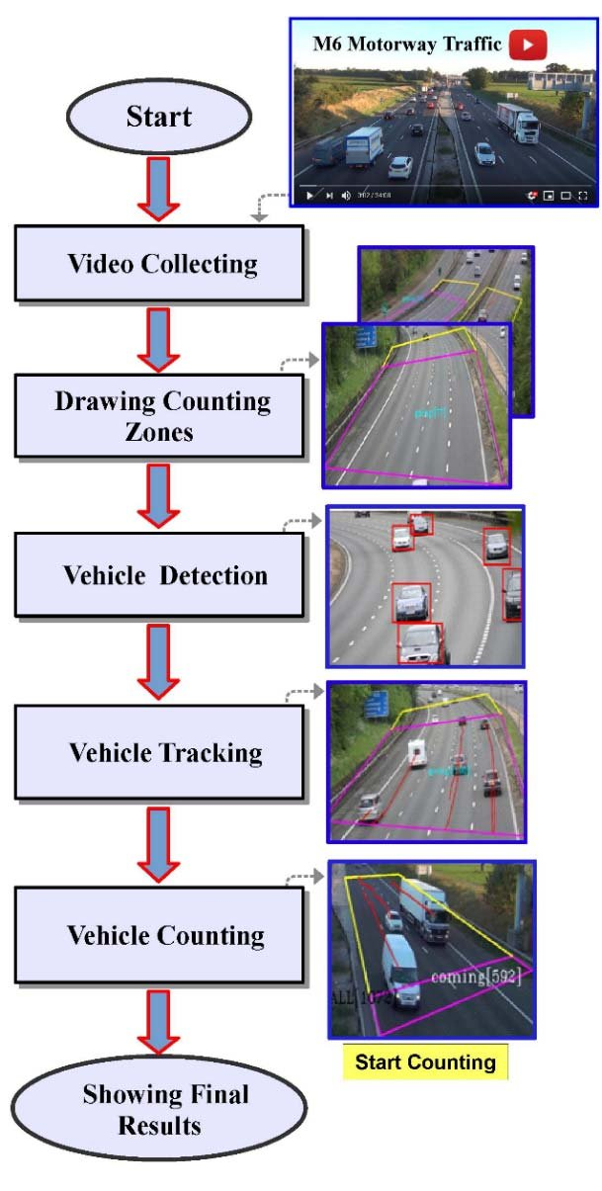
BLOCK DIAGRAM

Slide 7
components

Slide 8
ADVANTAGES
Real-time Processing: OpenCV provides efficient algorithms and tools for real-time image and video processing
Accuracy: OpenCV provides a wide range of algorithms and techniques for object detection, including vehicles
Robustness: OpenCV offers robust algorithms that can handle challenges such as varying vehicle sizes, orientations, and occlusions
Customization: OpenCV is an open-source library, which means developers have access to the source code and can customize algorithms according to specific requirements.
Integration: OpenCV is compatible with various programming languages including Python, C++, and Java, making it easy to integrate with existing systems and applications
Scalability: OpenCV is scalable and can be deployed across different platforms including desktops, embedded systems, and cloud infrastructure.
Low Cost: OpenCV is open-source and freely available, making it a cost-effective solution for vehicle detection and counting compared to proprietary software or third-party solutions.
.

Slide 9
APPLICATIONS
Real-time Detection: Once trained, the model can be used for real-time vehicle detection.
Post-processing: After obtaining bounding box predictions, apply post-processing techniques to refine the results.
Tracking and Counting: If counting vehicles over time is required, implement a tracking algorithm to associate detections across frames
Training the Object Detection Model: Train a deep learning object detection model like YOLOv3 or YOLOv4 on the annotated dataset
Data Collection and Preprocessing: Gather a large dataset of images or videos containing various scenes with vehicles. Annotate these datasets with bounding boxes around the vehicles.
Performance Optimization: Depending on the specific application, optimize the algorithm for speed and efficiency.

Slide 10
Thank You

